Slide 1

P1 PROJECT • 4-BIT ALU
Vivado 202X • Artix-7 xc7a100t
Resource-Shared 4-Bit ALU: Gate-Level Design, Verification & Implementation
Comprehensive architecture specification, self-checking testbench verification, and FPGA physical synthesis on AMD Xilinx Artix-7.
STUDENT
DEPARTMENT
VERIFICATION STATUS
DEVICE UTILIZATION
Tran Quan Bao
Microelectronics & IC Design
100% Tests Passed
60 LUTs • 18 FFs
ID: SE190570
FPT University
0 Simulation Errors
Ultra-Compact Area

Slide 2

PART A (1/3) • HARDWARE ARCHITECTURE
Module Hierarchy & 30-Pin I/O Interface
30-Pin External I/O Specification
6 Submodules (alu_4bit.v)
INPUT SIGNALS (15 PINS)
ctrl: Opcode instruction decoder unit.
clk, rst, start • Clock, Reset, Start
opcode[3:0] (4b) • Operation select
a[3:0], b[3:0] (8b) • 4-bit data operands
adder_sub_u: 4-bit adder/subtractor with carry chain.
logic_u: Bitwise AND, OR, XOR, NOT operations.
shifter_u: Single-bit logical left/right shifts.
OUTPUT SIGNALS (15 PINS)
muldiv_u: 4-cycle sequential Multiply/Divide FSM.
result[7:0] (8b) • Computed datapath output
carry, zero, overflow, negative (4b)• Status flags
busy, done, div_by_zero (3b) • Control & Exception
flags_u: Status flags logic for C, Z, V, and N.

Slide 3
PART A (2/3) • HARDWARE OPTIMIZATION
Resource-Shared Datapath Architecture
Area Optimization Goal
Dynamic Datapath MUX
Zero dedicated adders for multiplication and division routines. A single 4-bit Ripple-Carry Adder handles all arithmetic tasks.
The active busy control line switches adder inputs dynamically between combinational and multi-cycle sequential states.
Control Multiplexer | Adder Input Port | Mode 0: Combinational (busy = 0) | Mode 1: Sequential (busy = 1)
mux_add_a | Operand A (4-bit) | External input a[3:0] | Accumulator register md_add_a[3:0]
mux_add_b | Operand B (4-bit) | External input b[3:0] | Multiplicand / Divisor md_add_b[3:0]
mux_add_sub | Add/Sub Control | Decoded sub line (Op 0001) | Restoring trial subtract md_add_sub

Slide 4


PART A (3/3) • GATE-LEVEL FOUNDATIONS
Boolean Equations & Submodule Algorithms
1. Full Adder Core
2. 4-Cycle FSM Core
Multiply (Op 1000): 4-cycle Shift-and-Add algorithm.
3. Status Flag Logic
Sum: sum_i = a_i ^ b_inv_i ^ c_i
Carry: c_(i+1) = (a_i & b_inv_i) | ((a_i ^ b_inv_i) & c_i)
V (Overflow): arith & (c3 ^ c4)
Divide (Op 1001): 4-cycle Restoring division scheme.
C (Carry): (arith & c4) | (is_shl & a[3]) | (is_shr & a[0])
2's Comp: b_inv[i] = b[i] ^ sub, c0 = sub
Exception: Instant div_by_zero = 1 flag assertion.
Z (Zero): ~(|result), N: result[3]

Slide 5



PART B (1/2) • VERIFICATION ARCHITECTURE
Automated Self-Checking Testbench (alu_4bit_tb.v)
Clock & Reset Setup
Vector Test Coverage
Automated Error Counter
100 MHz clock rate with 10 ns periods. Active-high asynchronous reset clears all internal registers during the initial 20 ns window.
Phase 1: Verifies 8 combinational operations (3,584 automated vectors).
Phase 2: Verifies 4-cycle sequential MUL/DIV and division-by-zero exceptions (512 automated vectors).
Total Coverage: 4,096 comprehensive test cases with zero errors.
A 32-bit internal counter compares actual outputs with golden models. Simulation returns clean PASS only when zero errors occur.

Slide 6
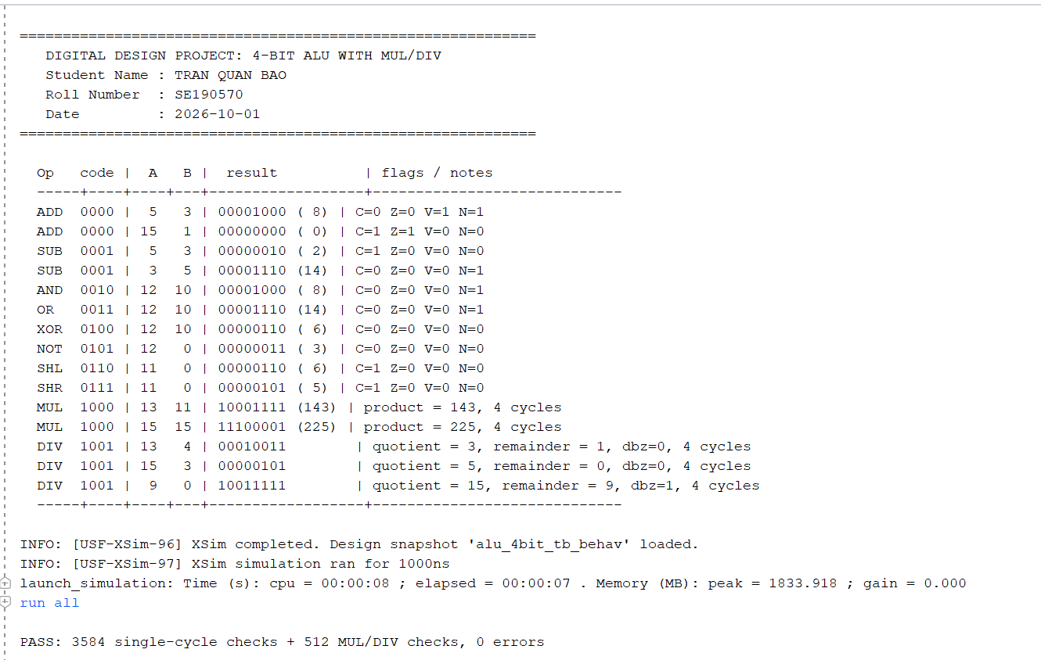
PART B (2/2) • SIMULATION OUTPUT
Vivado XSim Tcl Console Log & PASS Validation
STATUS: 0 ERRORS DETECTED
// VIVADO TCL CONSOLE SIMULATION LOG — 4-BIT ALU VERIFICATION
--------------------------------------------------------------------------------
--------------------------------------------------------------------------------
Target FPGA Device: xc7a35tcpg236-1
Full Verification Run Completed

Slide 7
PART C • WAVEFORM CORRELATION
Simulation Truth Table & Status Flag Behavior
Time (ns) | Opcode | Operation | a, b | Result | C Z V N | Waveform Verification Notes
0 - 20 | 0000 | RESET (rst=1) | 0, 0 | 00 | 0 1 0 0 | Registers cleared, Zero flag asserts high.
20 - 30 | 0000 | ADD (a + b) | 5, 3 | 08 | 0 0 1 1 | Signed overflow (+5 + +3 = +8 -> negative).
30 - 40 | 0000 | ADD (a + b) | 15, 1 | 00 | 1 1 0 0 | Unsigned wrap-around, Carry=1, Zero=1.
40 - 50 | 0001 | SUB (a - b) | 5, 3 | 02 | 1 0 0 0 | Carry=1 indicates no borrow (positive result).
50 - 60 | 0001 | SUB (a - b) | 3, 5 | 0E | 0 0 0 1 | Negative result (3 - 5 = -2 in 2's comp), Carry=0 (borrow).
60 - 180 | 0010-0111 | LOGIC & SHIFT | Var | [Data] | x x x x | Combinational AND, OR, XOR, NOT, SHL, SHR.
180 - 235 | 1000 | MUL (a * b) | 13, 11 | 8F (143) | 0 0 0 0 | busy=1 for 4 clock cycles, latched at done=1.
245 - 385 | 1001 | DIV & DIV_0 | 13, 4 / 9, 0 | 13h / Hold | 0 0 0 0 | Valid quotient=3, remainder=1; div_by_zero=1 on 9/0.

Slide 8
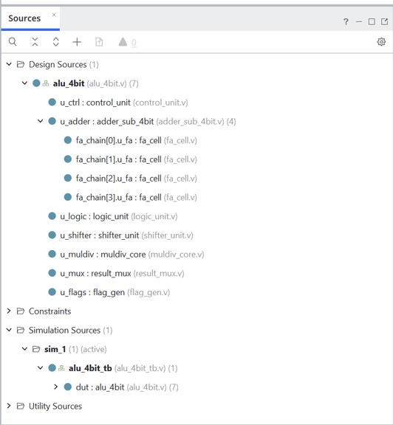
STEP 1 (EVIDENCE F1) • PROJECT SETUP
Project Creation & RTL Hierarchy Synthesis
Vivado Project Flow Explanation
1. ACTION TAKEN
Initialized target project for AMD Artix-7 (xc7a35tcpg236-1) and linked all top/submodule Verilog source files.
2. OBSERVED EVIDENCE
Project Manager tree resolved top-level entity and 7 nested submodules
with 0 errors/warnings
3. TECHNICAL SIGNIFICANCE
Valid port mapping across 30 I/O pins established for clean elaboration and synthesis.

Slide 9
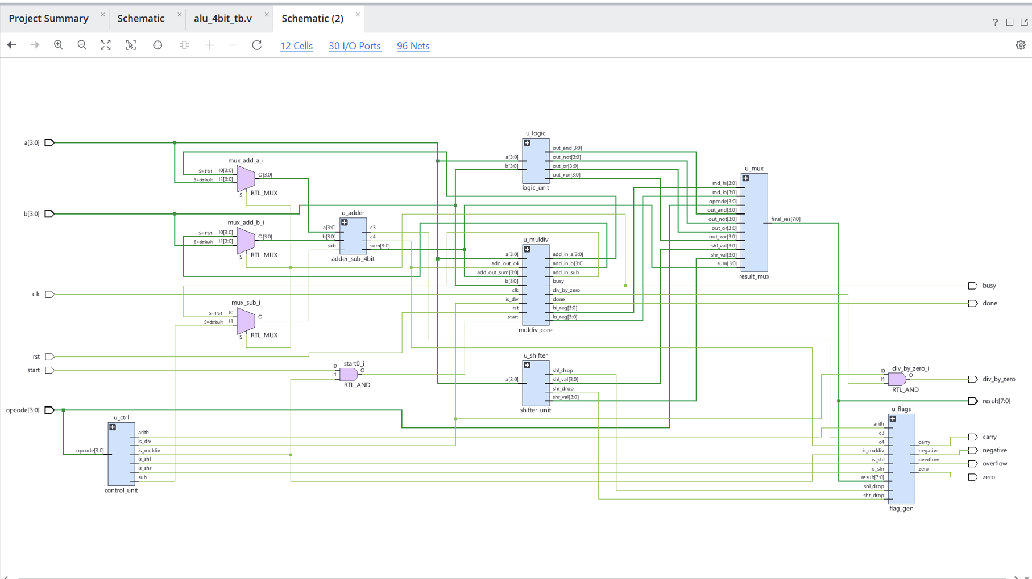
STEP 2 (EVIDENCE F2) • RTL ELABORATION
Schematic Elaboration & Vivado Linter Analysis
Elaboration & Static Linting Flow
1. ACTION TAKEN
Extracted gate-level schematic netlist from RTL code and executed Vivado static lint rules.
2. OBSERVED EVIDENCE
Resolved top-level interconnects (12 Cells, 30 I/O Ports, 96 Nets) linking 7 functional submodules without errors.
3. TECHNICAL SIGNIFICANCE
Zero unintended latches inferred; clean combinational paths and sequential clock domains.

Slide 10
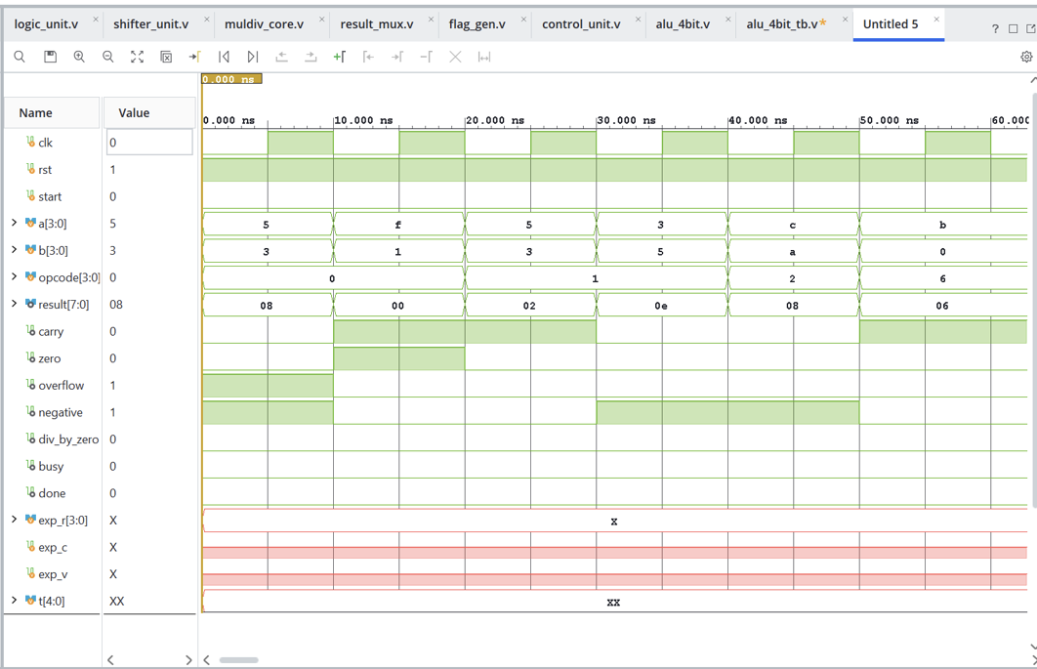
STEP 3 (EVIDENCE F3) • WAVEFORM SIMULATION
Waveform Simulation: Combinational Operations & Flag Verification
Combinational Verification Flow
1. ACTION TAKEN
Ran behavioral simulation in Vivado XSim across arithmetic, bitwise, and shift opcodes (0 to 7).
2. OBSERVED EVIDENCE
Zero-delay response across all outputs with arithmetic flags strictly matching golden equations.
3. TECHNICAL SIGNIFICANCE
Verified 2's complement subtraction and signed overflow detection without glitching.

Slide 11
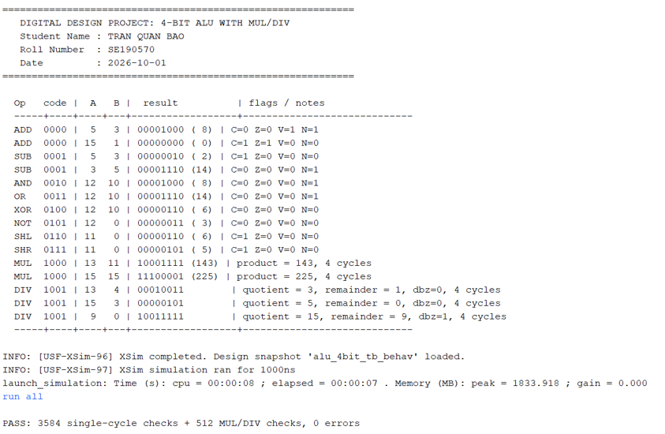
STEP 4 (EVIDENCE F4) • TCL CONSOLE VALIDATION
Vivado Tcl Console & Automated Testbench PASS Result
Automated Verification & Log Validation
1. ACTION TAKEN
Executed exhaustive self-checking testbench (alu_4bit_tb.v) in Vivado XSim covering single-cycle and sequential operations.
2. OBSERVED EVIDENCE
Console printed verified sample outputs alongside personal watermark (TRAN QUAN BAO - SE190570) and logged "PASS: 3584 single-cycle checks + 512 MUL/DIV checks, 0 errors".
3. TECHNICAL SIGNIFICANCE
Validates 100% functional test coverage across 4,096 automated verification vectors with zero arithmetic or state machine flaws.

Slide 12
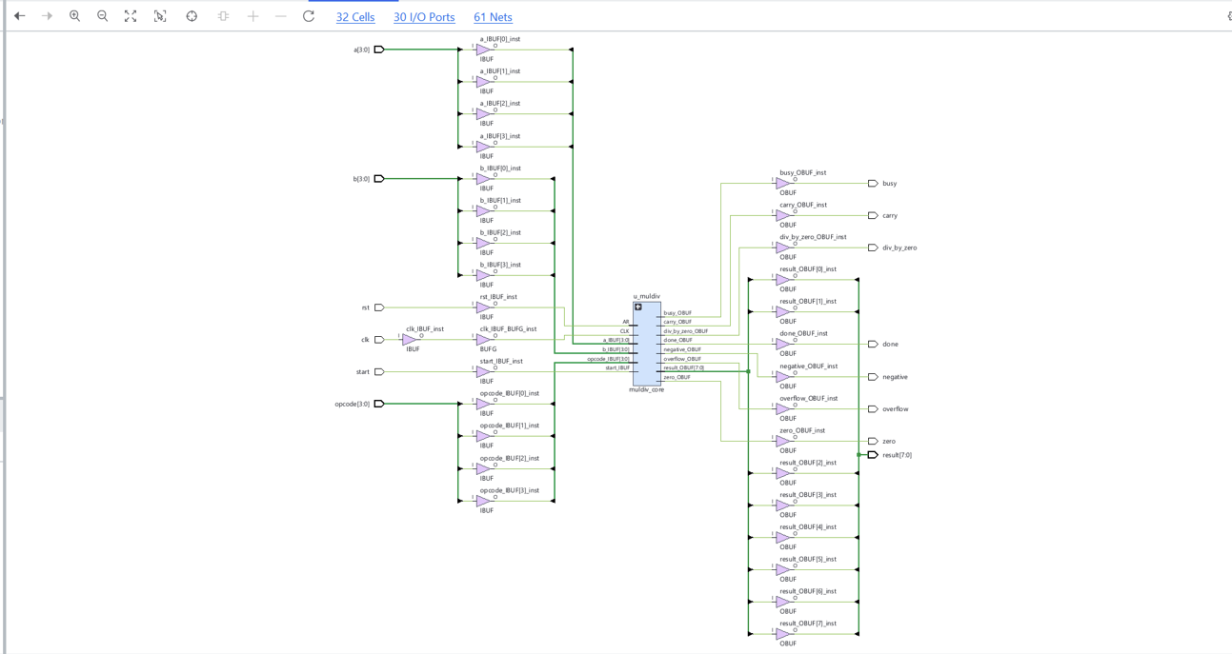
STEP 5 (EVIDENCE F5) • LOGIC SYNTHESIS
Vivado Tcl Console & Automated Testbench PASS Result
Logic Synthesis & Technology Mapping Flow
1. ACTION TAKEN
Ran Vivado Logic Synthesis targeting AMD Artix-7 (xc7a35tcpg236-1) with Vivado Synthesis Defaults strategy.
2. OBSERVED EVIDENCE
Generated post-synthesis gate-level netlist consisting of 32 Cells, 30 I/O Ports, and 61 Nets with status "synth_design Complete!".
3. TECHNICAL SIGNIFICANCE
RTL descriptions successfully mapped to physical Xilinx hardware primitives: IBUF/OBUF pin buffers, 6-input LUTs for datapath logic, and FDRE registers for sequential control.

Slide 13
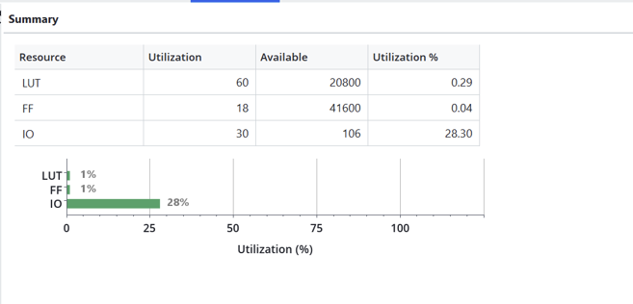
STEP 6 (EVIDENCE F6) • PHYSICAL IMPLEMENTATION
Hardware Synthesis & Resource Utilization Report
FPGA Resource | Used / Available | Utilization %
Slice LUTs | 60 / 20,800 | 0.29%
Flip-Flops (FF) | 18 / 41,600 | 0.04%
Bonded IOBs | 30 / 106 | 28.30%
Design Takeaway: The resource-shared adder architecture dramatically cuts LUT consumption compared to designs implementing dedicated arithmetic sub-blocks.

Slide 14


STEP 7 (EVIDENCE F7) & PROJECT SUMMARY
Project Conclusions & Key Achievements
SUBMISSION COMPLETE
Gate-Level RTL Design
Resource Sharing
Automated Verification
Vivado Flow Executed
Integrated all 7 hierarchical submodules from ground-up structural logic.
Adder-sharing datapath reduced silicon utilization to an ultra-compact 60 LUTs.
Self-checking testbench confirmed 100% test coverage with zero errors.
Completed Vivado design flow through logic synthesis and resource mapping on Artix-7.
Thank You for Your Time & Attention

